Slide 1
Nodejs & intro MEAN
Rajeev Gupta rgupta.mtech@gmail.com Java trainer & consultant

Slide 2
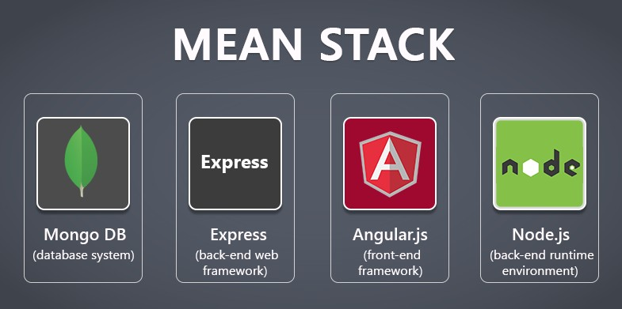
What is MEAN?

Slide 3
What is MEAN?
M = MongoDB --> DATA solution
E = Express JS (for use with nodeJS) -->
Routing and ease of transactions (above simple NodeJS) , session management, server side
A = AngularJS (for use with nodeJS) --> Presentation layer ease (above simple NodeJS) THIS IS CLIENT SIDE MVC
N = NodeJS -->
Plateform for javascript frameworks Express and Angular built on top of nodejs used for serverside programs, server side

Slide 4
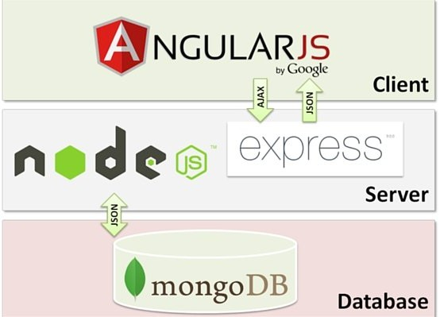
MEAN application flow

Slide 5
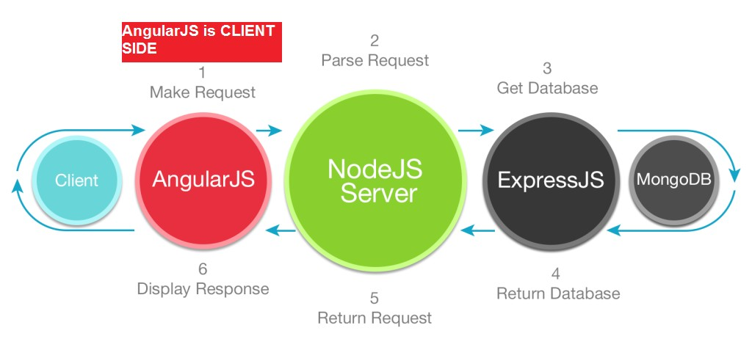
User Request Processing MEAN
Here we can see how a user/client requests is processed and response returned

Slide 6
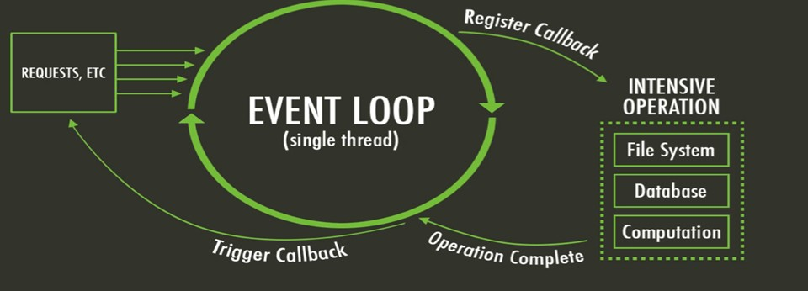
What does Angular give us
What is a single page application?
Angular used to create Single Page Application (SPA)
SPA = Think of Yahoo! or Google Mail as examples.
runs inside single page load, just updates part of the page as you need it.
Positives: once you load it, it has fast response, moves some of computation to client side (in Angular)

Slide 7
How JavaScript work in Browser
What you are JavaScript?
I hava a call stack, an event loop, a callback queue and other apis and stuff

Slide 8
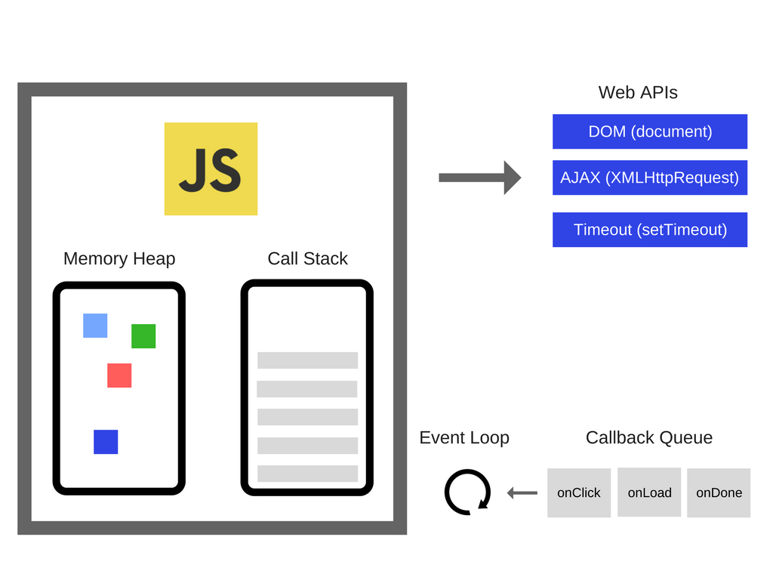
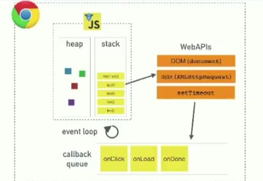
How JavaScript work in Browser

Slide 9
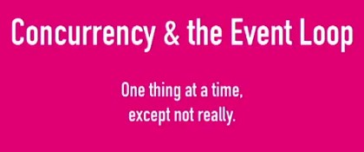
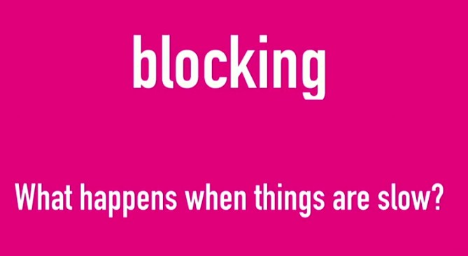
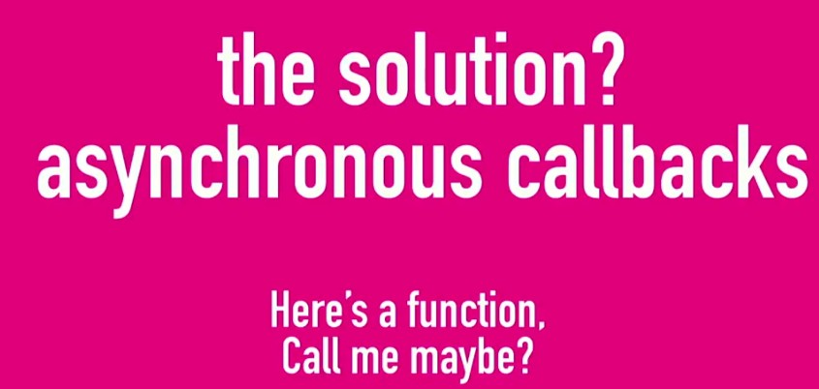
How JavaScript work in Browser

Slide 10
How JavaScript work in Browser
Javascript run in single thread but browser have Web API that can do other these, uses threads ( in node we have c++ api)

Slide 11
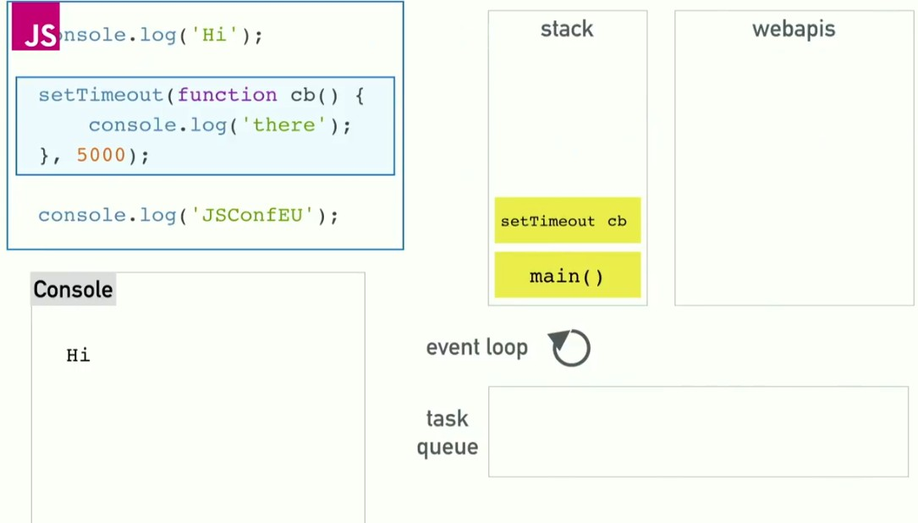
How JavaScript work in Browser

Slide 12
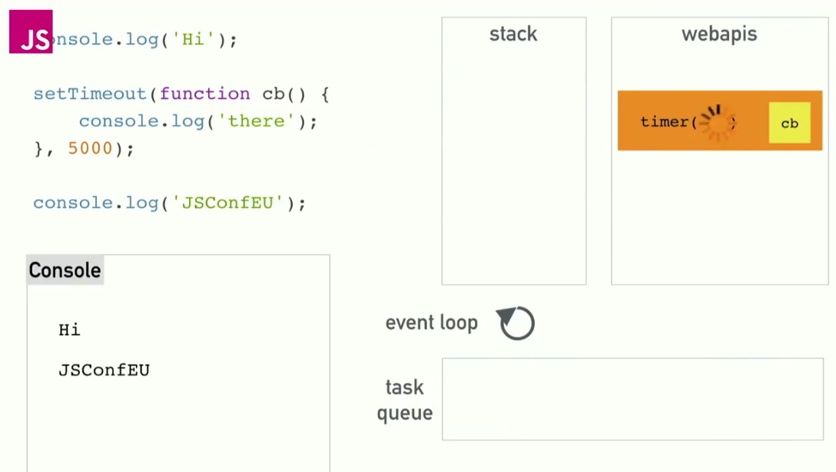
How JavaScript work in Browser
When webapis done there job they push call back function into the task queue, event loop have simple job once stack is empty, push that call back on the top of stack

Slide 13
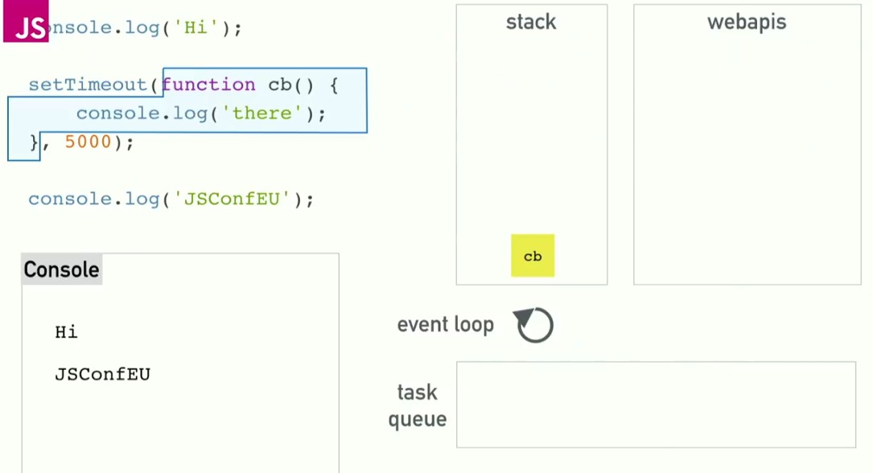
How JavaScript work in Browser

Slide 14
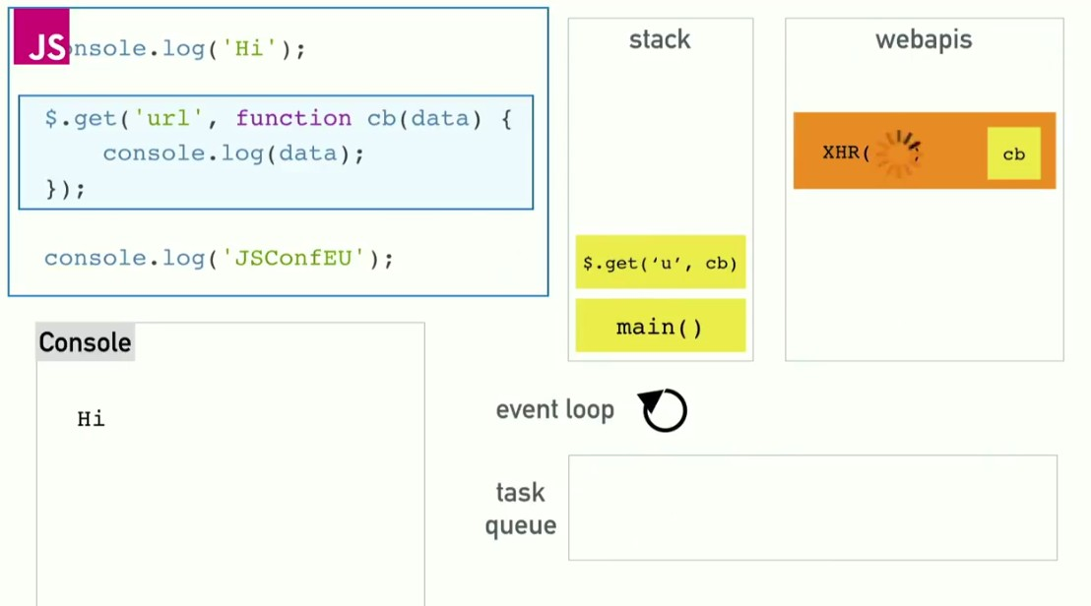
How JavaScript work in Browser

Slide 15
What is node.js ?
Node.js is an open-source, cross-platform runtime environment used for the development of server-side web applications. Node.js applications are written in JavaScript and can be run on a wide variety of operating systems.
Node.js is based on an event-driven architecture and a non-blocking Input/Output API that is designed to optimize an application's throughput and scalability for real-time web applications.
Created in 2009
Evented I/O for JavaScript
Server Side JavaScript
Runs on Google's V8 JavaScript Engine

Slide 16
Why Use Node.js ?
Node's goal is to provide an easy way to build scalable network program
Asynchronous event-driven IO helps concurrent request handling
This feature basically means that if a request is received by Node for some Input/Output operation, it will execute the operation in the background and continue with processing other requests.
Node uses the V8 JavaScript Runtime engine
The Node.js library uses JavaScript
Active and vibrant community for the Node.js framework

Slide 17
What is unique about Node.js?
1. JavaScript on server-side thusmaking communication between client and server will happen in same language
2. Servers normally thread based but Node.JS is “Event” based. Node.JS serves each request in a Evented loop that can handle simultaneous requests

Slide 18
When to go for Node?
When to Use Node.js
Node.js is best for usage in streaming or event-based real-time applications like Chat applications
Game servers – Fast and high-performance servers that need to processes thousands of requests at a time, then this is an ideal framework.
Good forcollaborative environment – This is good for environments which manage documents. In a document management environment, you will have multiple people who post their documents and do constant changes by checking out and checking in documents. So Node.js is good for these environments because the event loop in Node.js can be triggered whenever documents are changed in a document managed environment.
Advertisement servers – Again here you could have thousands of request to pull advertisements from the central server and Node.js can be an ideal framework to handle this.
Streaming servers – Another ideal scenario to use Node is for multimedia streaming servers wherein clients have request's to pull different multimedia contents from this server

Slide 19
When not to go for Node?
The only scenario where it should not be used is where there are long processing times, which is required by the application.
Node is structured to be single-threaded. If an application is required to carry out some long-running calculations in the background, it won't be able to process any other requests. As discussed above, Node.js is used best where processing needs less dedicated CPU time. r

Slide 20
Threads VS Event-driven
Threads | Asynchronous Event-driven
Lock application / request with listener-workers threads | only one thread, which repeatedly fetches an event
Using incoming-request model | Using queue and then processes it
multithreaded server might block the request which might involve multiple events | manually saves state and then goes on to process the next event
Using context switching | no contention and no context switches
Using multithreading environments where listener and workers threads are used frequently to take an incoming- request lock | Using asynchronous I/O facilities (callbacks, not poll/select or O_NONBLOCK) environments

Slide 21
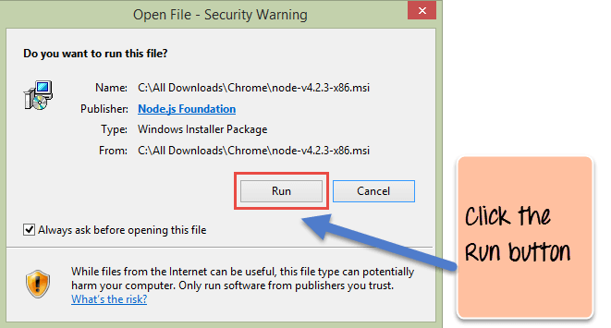
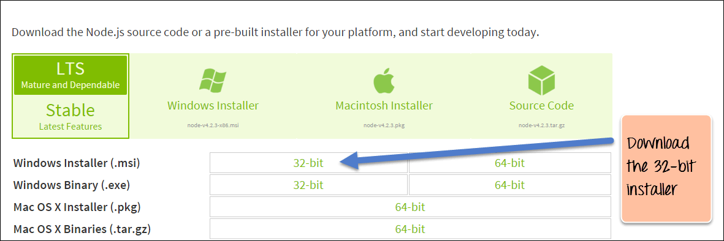
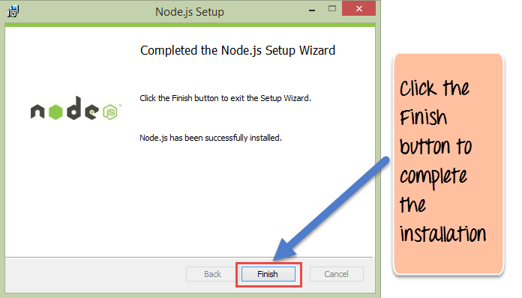
Installation

Slide 22
Node.js VS Apache
It's faster
It can handle tons of concurrent requests
Platform |  | Number of request per second
PHP ( via Apache) |  | 3187,27
Static ( via Apache | ) | 2966,51
Node.js |  | 5569,30

Slide 23

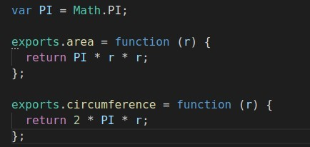

Hello world Nodejs
●
Printing loop
●
Using modules

Slide 24
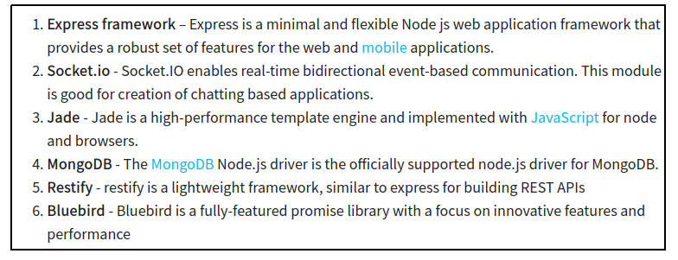
What are modules in Node.js?
modules in Node js are a way of encapsulating code in a separate logical unit

Slide 25
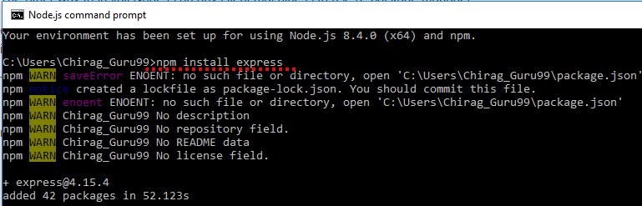
How to install modules in Node.js?
In order to use modules in a Node.js application,
they first need to be installed using the Node package manager.
The below command line shows how a module "express" can be installed.
npm install express

Slide 26
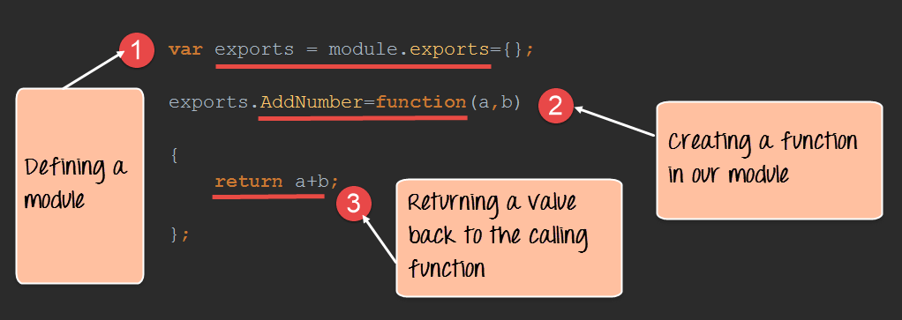
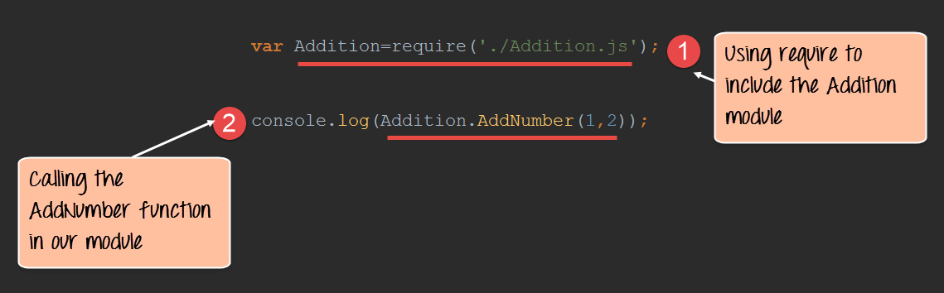
How to create Custom modules?
modules in Node js are a way of encapsulating code in a separate logical unit

Slide 27
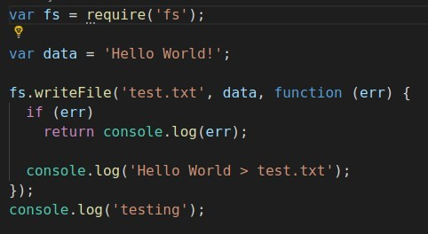
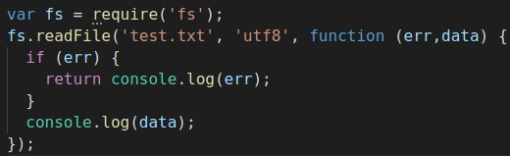
Reading/ Writing data on file
●
Writing
●
Reading

Slide 28
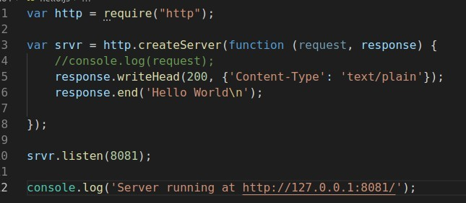
Create HTTP Web Server in Node.js

Slide 29
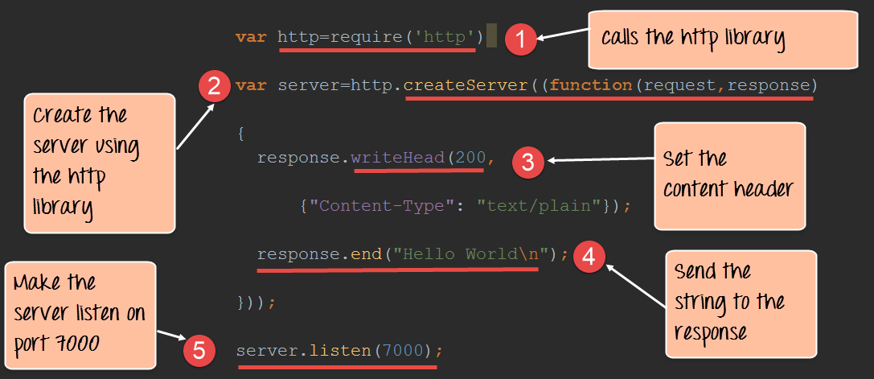
Create HTTP Web Server in Node.js

Slide 30
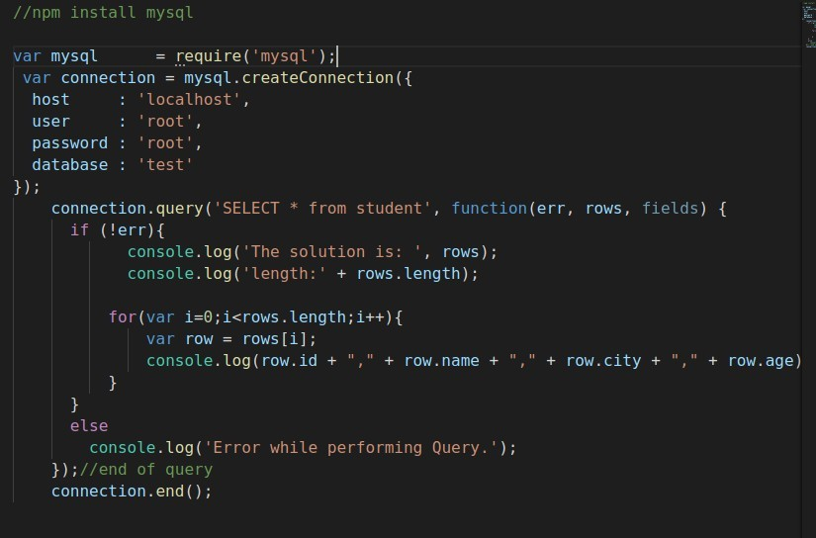
Connect with mysql

Slide 31
File package.json
"name": "node-js-getting-started", "version": "0.2.5",
"description": "A sample Node.js app using Express 4", "engines": {
"node": "5.9.1"
},
"main": "index.js", "scripts": {
"start": "node index.js"
},
"dependencies": {
"body-parser": "^1.16.1",
"cookie-parser": "^1.4.3",
"cool-ascii-faces": "1.3.4",
"ejs": "2.4.1",
"express": "^4.13.3",
"express-session": "^1.15.1",
"mongodb": "^2.2.24",
"multer": "^1.3.0",
"pg": "4.x",
"pug": "^2.0.0-beta11"
},
"repository": { "type": "git",
"url": "https://github.com/heroku/node-js-getting-started"
},
"keywords": [
"node",
"heroku", "express"
],
"license": "MIT"
Project information
Name
Version
Dependencies
Licence
Main file
Etc...

Slide 32
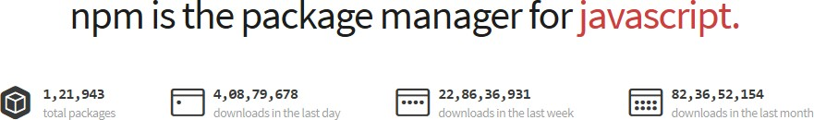
Node.js Modules….. MANY
https://npmjs.org/
# of modules = 1,21,943
Install a module…..inside your project directory
$npm install <module name>
Using module….. Inside your javascript code
var http = require(‘http’);
var fs = require(‘fs’);
var express = require(‘express’);

Slide 33
Hello World Example
Create file index.js with the following code:
http.createServer(function (request, response) {
// Send the HTTP header
// HTTP Status: 200 : OK
// Content Type: text/plain response.writeHead(200, {'Content-Type':
'text/plain'});
// Send the response body as "Hello World“ response.end('Hello World\n'); }).listen(8081);
// Console will print the message
console.log('Server running at http://127.0.0.1:8081/');
$ node app.js

Slide 34
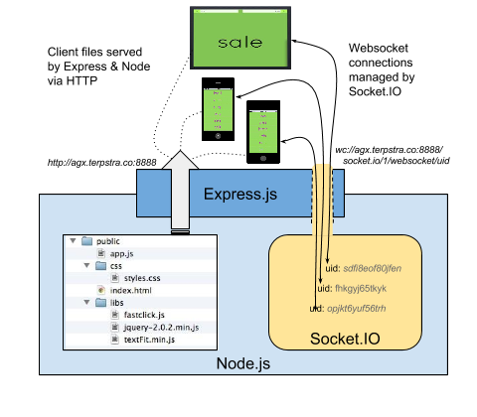
Express
minimal and flexible Node.js web application framework that provides a robust set of features for web and mobile applications.

Slide 35
Express
Express gives ease of functionality
Routing
Delivery of Static Files
“Middleware” – some ease in development (functionality)
Form Processing
Simple forms of Authentication
Cookies and Session Manipulation
A lot of this you can do in NodeJS but, you may write more code to do it than if you use the framework Express.

Slide 36
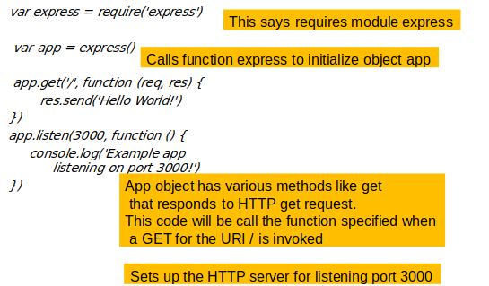
Hello world

Slide 37
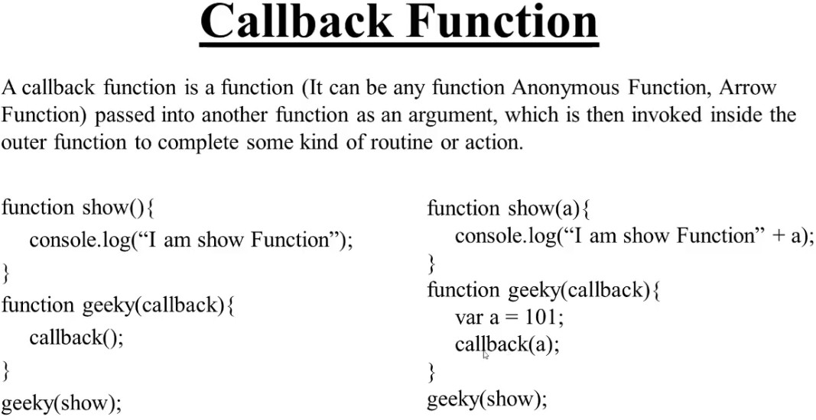

Slide 38
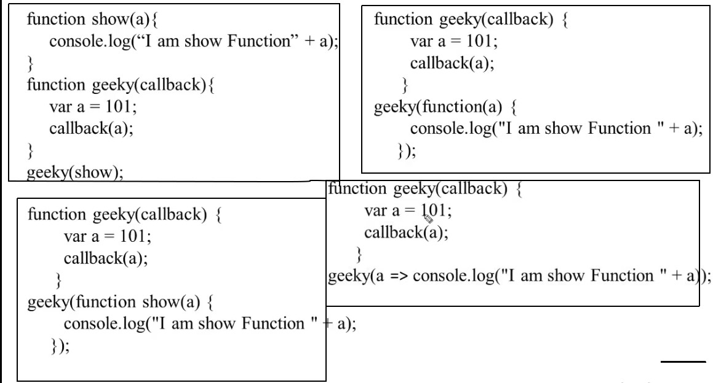

Slide 39
